Slide 1


DEPARTMENT OF COMPUTER SCIENCE AND ENGINEERING
20CS7503 & DESIGN PROJECT – III
END SEMESTER PRACTICAL EXAMINATION- NOV / DEC 2025
REVIEW PRESENTATION
Batch No:3
Date :29.11.25
Session:FN

Slide 2
TITLE OF THE PROJECT
AI-Powered Authorized Area Monitoring and Alert System
Guide Name:
Mrs. M.SURIYA,
Assistant Professor ,
CSE
Team Members:
SAHAANA.S (811722104127)
SHARVINI.S (811722104145)
THENNARASI.M (811722104168)

Slide 3
OBJECTIVE OF THE PROJECT
- Develop an intelligent security system that uses YOLOv8 for real-time detection of unauthorized objects and individuals within restricted areas.
- Automate the process of monitoring by reducing reliance on manual human supervision and traditional CCTV setups.
- Instantly alert security personnel via email and audio alarms whenever prohibited objects are detected in the monitored zone.

Slide 4
INTRODUCTION
1. Security and surveillance are essential in modern society, especially in sensitive environments such as educational institutions, corporate offices, and research labs.
2.Traditional surveillance systems, which depend on manual observation, are prone to errors, fatigue, and slow response, creating the need for more intelligent solutions.
3.AI-based object detection, particularly using deep learning models like YOLOv8, offers significant advantages in accuracy and automation for real-time monitoring.

Slide 5
LITERATURE SURVEY
TITLE OF PAPER | AUTHOR(S) | PAPER GIST | TECHNOLOGY USED
Visual interpretation of motion patterns for security surveillance systems | V. Pavlovic, R. Sharma, T. Huang | Analysis of motion patterns to recognize actions and enhance automated security surveillance | Computer vision, motion analysis, pattern recognition
A survey of computer vision‑assisted surveillance | R. T. Azuma | Overview of computer vision techniques for surveillance and real-time monitoring | Computer vision, motion tracking, environment modeling
Rapid object detection using a boosted cascade of simple features forreal‑time surveillance | P. Viola, M. Jones | Fast object detection using cascaded classifiers and simple features for real-time applications | Haar-like features, AdaBoost, cascaded classifiers

Slide 6
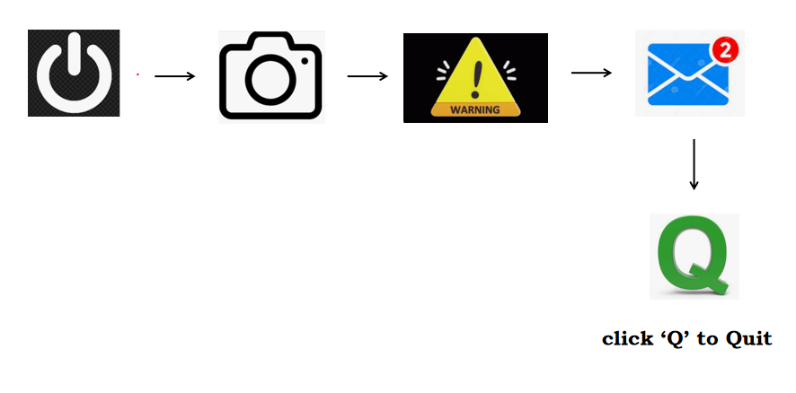
EXISTING SYSTEM ARCHITECTURE

Slide 7
PROBLEM IDENTIFICAITON
1.Most current surveillance cameras lack real-time object detection and threat classification, leading to delayed responses and unnoticed unauthorized activities since footage must be manually reviewed by security personnel.
2. Traditional monitoring systems do not automatically send alerts when unauthorized objects or individuals enter restricted zones, relying heavily on human observation which is error-prone and inefficient
3.Existing systems typically detect only basic motion or human activity and cannot accurately identify specific prohibited items such as mobile phones, weapons, bottles, or documents, increasing the risk of security breaches

Slide 8
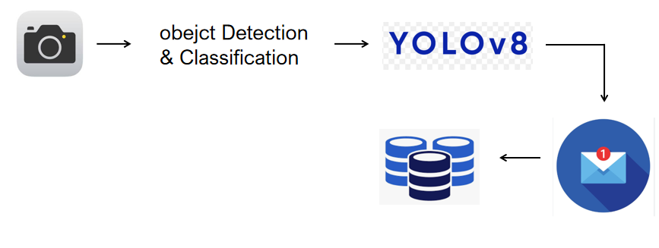
PROPOSED SYSTEM ARCHITECTURE

Slide 9
SOFTWARE AND HARDWARE REQUIREMENTS
HARDWARE
1.Processor
2.RAM
3.Storage
4.GraphicsDriver Webcam
5.PowerSupply
SOFTWARE
1.OperatingSystem
2.PythonVersion
3.PythonLibraries
4.IDE
5.WebcamDriver
6.ModelFile
7.E-MailConfiguration AlarmFile

Slide 10
MODULES
1.Object Detection and Classification Module
2.Authorized Object Verification Module
3.Real-Time Monitoring and Event Trigger Module
4.Alert and Notification Module.
5.Image Logging and Evidence Storage Module
6.User Interface and System Control Module

Slide 11
IMPLEMENTATION OF MODULE-1
Object Detection and Classification Module
1.Uses YOLOv8 deep learning model for real-time detection from webcamvideo feed
2.Identifies multiple objects with bounding boxes, labels, and confidence scores.
3.Utilizes pre-trained weights on COCO dataset for recognizing common categories accurately.

Slide 12
IMPLEMENTATION OF MODULE-2
Authorized Object Verification ModuleCompares detected
1.objects against a predefined list of authorized items.
2.Flags items not in the authorized list as suspicious or unauthorized.
3.Supports adaptable authorized lists based on the environment (e.g., exam halls vs office).

Slide 13
IMPLEMENTATION OF MODULE-3
Real-Time Monitoring and Event Trigger Module
1.Continuously captures and processes video frames for uninterrupted monitoring.
2.Triggers alerts only when violations occur to prevent alert spamming.
3.Acts as the surveillance watchdog by evaluating deviations and abnormal events.

Slide 14
IMPLEMENTATION OF MODULE-4
Alert and Notification Module.
1.Sends real-time warnings via email (SMTP/Gmail) with detailed violation info.
2.Activates on-site audible alarms to deter unauthorized activity immediately.
3.Provides dual alert mechanism for both local and remote situational awareness.

Slide 15
IMPLEMENTATION OF MODULE-5
Image Logging and Evidence Storage Module
1.Saves captured images of detections in separate folders for authorized and unauthorized.
2.Timestamps images to maintain accurate surveillance history.
3.Supports audit, investigation, and accountability through visual documentation.

Slide 16
IMPLEMENTATION OF MODULE-6
User Interface and System Control Module
1.Manages real-time video display with bounding boxes and object labels using OpenCV.
2.Offers easy controls (e.g., press Q to quit) for non-technical users.
3.Synchronizes system components to ensure smooth and efficient monitoring workflow.

Slide 17
CONCLUSION
1.The AI-powered authorized area monitoring system using YOLOv8 achieves reliable real-time detection and classification of unauthorized objects.
2.Automated alarm activation and email notifications enhance response times and enable immediate security actions.
3.The system’s image logging supports post-incident analysis, improving accountability and documentation.

Slide 18
FUTURE ENHANCEMENTS
1.Integration of multi-camera networks for simultaneous monitoring of large restricted areas with centralized alert management.
2.Cloud-based alerting and storage for secure remote access to images, logs, and notifications.
3.Development of mobile applications for Android and iOS to provide instant push notifications and live monitoring

